Slide 1
Who Are You?
Authentication Options in Alma
Betsy Friesen
ELUNA/IGeLU Alma WG Coordinator
Josh Weisman
VP Development, Resource Management, Ex Libris
ELUNA 2018
Notes:
Betsy- 15 minutes
Josh- 15 minutes
Questions- 10-15 questions

Slide 2
Agenda
Authentication Background and Collaborative Review
Identity Management Requirement Services
Authentication Options
Ex Libris Identity Service
Questions
Notes:
Mark

Slide 3
Authentication Background and Collaborative Review

Slide 4
Background
Fall 2016 - Summer 2017
Members of IGeLU, ELUNA and Ex Libris begin discussions about retiring Internal Authentication in Alma
ELUNA and IGELU Steering Committees Charge the Authentication Focus Group (AFG)
Michael North (Co-Chair), Northwestern University, ELUNA SC
Mark Dehmlow (Co-Chair), University of Notre Dame, IGeLU SC
Paul Joseph, University of British Columbia, ELUNA SC
David Allen, State Library of Queensland, IGeLU SC
Betsy Friesen, University of Minnesota, ALMA WG Coordinator
Mehmet Celik, KU Leuven, Interoperability WG Coordinator
Allen Jones, The New School, ELUNA Primo WG
Notes:
In September 2016, Ex Libris announced plans to move toward the use of external-only password management in Alma. This shift would affect customers’ ability to create patron and staff accounts where the password is stored within Alma.
Ex Libris is not trying to eliminate internal users. Only the authentication method needs to change

Slide 5
Collaboration: Who and How
Monthly conference calls with Ex Libris staff
Collaboration with user community through surveys to assess potential impact on community
Ongoing review and evaluation of 3rd party external authentication services by AFG and Ex Libris
Notes:
This was a highly collaborative effort with Ex Libris and the community.
Initial calls with Bar Veinstein, Dvir Hoffman, Josh Weisman
Later calls with Dvir, Josh and Reuven Oman
e have tried to accommodate the communities concerns

Slide 6
Identity Management Requirement Services

Slide 7
Identity & Access Management (IAM) Requirement Services to Support Alma Authentication
INSTITUTIONAL REQUIREMENTS
Meets institutional ID security/privacy
Least amount of staffing impact
Levels of institutional responsibility for ID product/system
Institutional workflow
ADDITIONAL CONSIDERATIONS
Applications to Sync Alma to the ID system
Consortia : Potential multiple auth systems
Cost
Patron ease of use
ExL ability to support the institutional suth system
SOLUTION FEATURES
Free and fee-based Service
Cloud hosting vs. Local hosting
User limits
2-factor authentication compatible
Integrates with Ex Libris products
Notes:
Technical Requirements of Identity & Access Management (IAM) Services to Support Alma Authentication
Institutional IAM Issues, Policies, and Methods
Review of Social Media Authentication
Review of Commercial Identity as a Provider (IaaP) Services
Review of Passwordless Services (Sign-in via email)

Slide 8
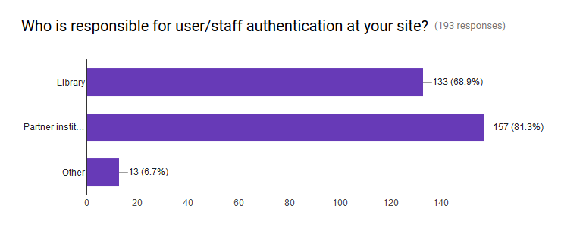
Institutional Authentication Methods Review
Institutional authentication methods and policies (Library vs. Central IT)

Slide 9
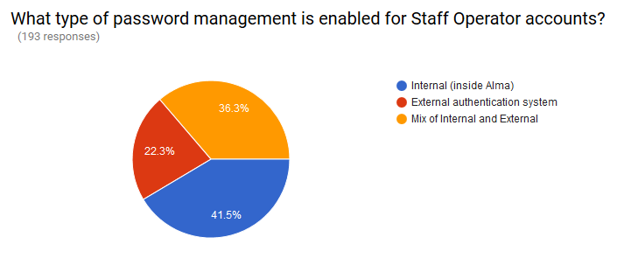
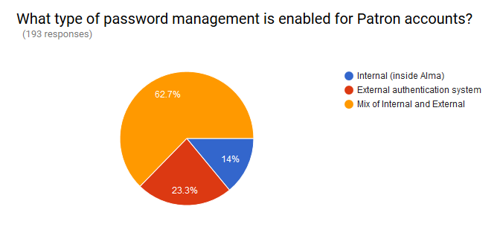
Institutional Authentication Methods Review
Notes:
External method examples: LDAP (Lightweight Directory Access Protocol), Shibboleth, Other locally developed application
89% of respondents provide access for non-affiliated users

Slide 10
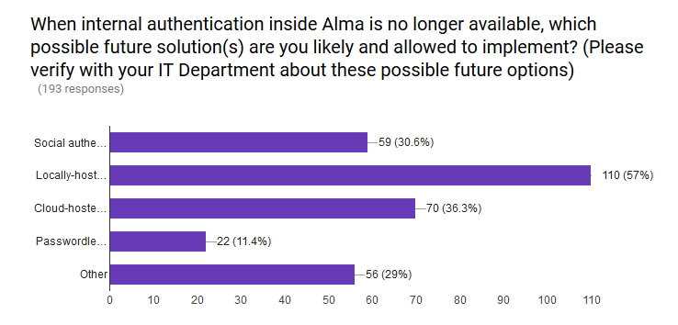
Institutional Authentication Methods Review

Slide 11
Authentication Options

Slide 12
Institutional Identity Providers
SAML
LDAP
CAS
Notes:
Josh

Slide 13
Social Login
Use case: Community borrowers who are not registered in the institutional identity provider
Avoids the need for the user to remember an additional username and password
No information shared between Alma and the social provider
Self registration available
Notes:
Josh

Slide 14
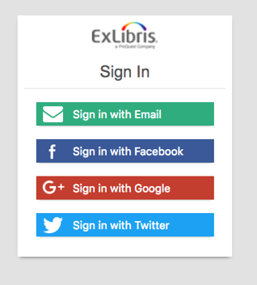
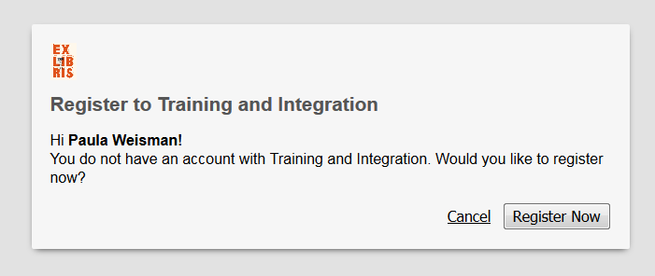
Social Login

Slide 15
Sign-in via email
Alternative to social login
Available for Primo (patrons) from June 2017
Available for Alma (staff) from Available from January 2018
Notes:
Josh

Slide 16
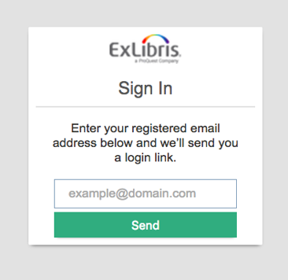
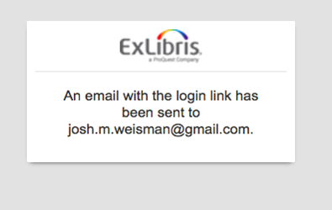
Sign-in via email
Users are registered in Alma with an email address by the circulation desk (or by the REST APIs)
When users wish to login to Primo, they select the “login via email” option and provide their registered email address

Slide 17
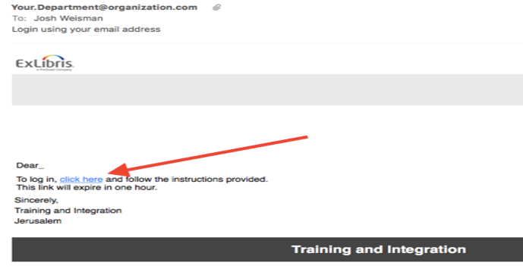
Sign-in via email
An email with a “magic link” is sent to the user. The user can click the link within 30 minutes and is automatically logged in to Primo. No password required.
The link is cryptographically signed to prevent spoofing

Slide 18
Ex Libris Identity Service

Slide 19
Ex Libris Identity Service
As a result of the work with the Authentication Focus Group, Ex Libris has decided to introduce an Ex Libris Identity Service that will be based on a dedicated identity management solution
Will replace the internal authentication / passwords method used today by live Alma customers and all existing customers will be migrated to this service.
FAQ: https://bit.ly/2HsW85n

Slide 20
Ex Libris Identity Service
“Internal users” are users who are created and managed in Alma, rather than an external system such as a Student Information System. Alma will continue to support internal users.
Internal users’ passwords will be stored in the “Ex Libris Identity Service,” a commercial, best-of-breed identity provider application hosted by Ex Libris in its data centers.

Slide 21
Ex Libris Identity Service- Flavors
Standard Service – this service will be included in the standard Alma annual subscription fee (no additional charge) and will allow the institution to authenticate up to 5,000 internal users.
Premium Service – this service will be an optional cost offering and will allow the institution to authenticate unlimited number of internal users. This option is designed to provide an effective solution to institutions without any identity management service that prefer not to use the other authentication methods.
existing Alma customers and customers that will sign their contract before June 30, 2018 will receive the premium service at no additional fee as part of the transition process to the new service.

Slide 22
Ex Libris Identity Service- Migration
The first time a user logs into Discovery or Alma after the service is launched, the user’s password will be automatically migrated out of Alma and into the service.
Users whose passwords do not meet the unified password strength policy will be asked to update their password as a part of their first login to Alma or Discovery.
Users who do not login during the migration period will be able to create a new password in one of two ways:
Using a “Forgot my password” link from Alma or Discovery; Alma will send an email with password reset instructions to the email address associated with the user
A user’s password can be reset by a librarian using Alma

Slide 23
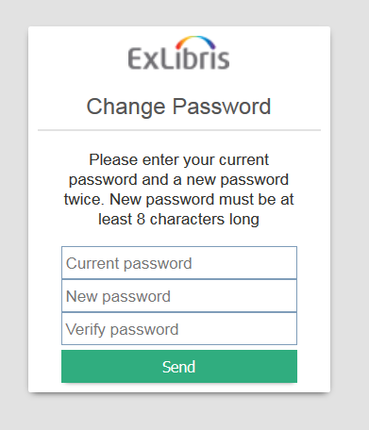
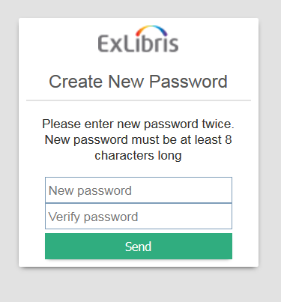
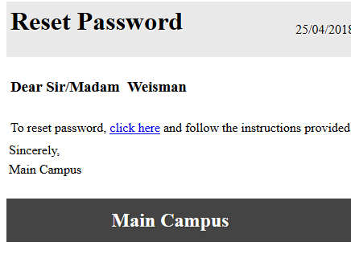
Ex Libris Identity Service
Migration of existing user to the Identity Service
If password meets requirements, transparent for the user
If password doesn’t meet requirements, will be required to enter a new password
Reset from Alma
From Alma, a staff user can reset the password manually or send an email for the user to reset their password

Slide 24
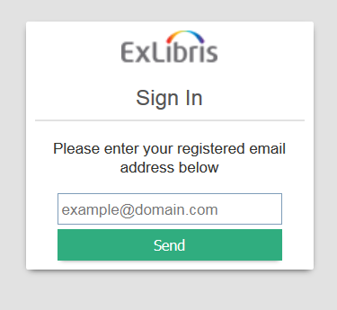
Ex Libris Identity Service
Reset password
If a user has no password in Alma (new customers, for example), the user can receive a reset password via email
Forgot password
It is possible to add a Forgot Password link to Primo to allow patrons to change their passwords

Slide 25
Questions???

Slide 26
THANK YOU !
Notes:
Mark

Slide 27
Moving Forward : What is Coming Next !
Finish Assessment
Matching Authentication Features Against the Preliminary Survey of Customer Needs
Will be Used to Update the Requirements Matrix
Present options to Customers in Third Survey
Results About How Customers Feel Their Needs are Met by Proposed Solutions Will be Published to Community
Review Results and Determine Additional Steps
Notes:
Michael

Slide 28
FAQ
Is there a timeline for the eventual end of passwords in Alma?
A deployment timeline will be set after agreement on the list of authentication options which will occur at a later date.
Will this impact any other Ex Libris products?
Yes, it will affect both Primo and Summon when deployed over Alma.
What support can customers expect from Ex Libris ?
Deployment and integration tools will be available from Ex Libris to make agreed-upon authentication options work smoothly and ensure easy transition.
Notes:
Josh

