Slide 1
HOW TO WRITE ALMA NORMALIZATION RULES
Steve McDonald
Tufts University

Slide 2
Goals of This Presentation
Define what normalization rules are, why they are important
Describe the basic syntax of normalization rules
Highlight some of the basic normalization actions
Explain how conditions can control the application of rules
Provide tips on writing good rules
Primary Goal: convince you that you can create and apply normalization rules

Slide 3
What Are Normalization Rules
Rules provide actions to add, remove, or modify MARC fields and subfields
Rules can be applied to a single MARC record or to an entire set of records
Changes can be restricted to records or fields which meet specific conditions
In essence, normalization rules are a very simplified programming language to edit MARC records

Slide 4
DEFINITION: Rules, Files, and Processes
Normalization rule: A set of actions and conditions to modify MARC records
Normalization rule file: A computer file containing normalization rules
Normalization process: An Alma job which can execute normalization rule files
Rules are stored in a file, and executed in a process

Slide 5
Why are Normalization Rules and Processes Important? How Can They Be Used?

Slide 6
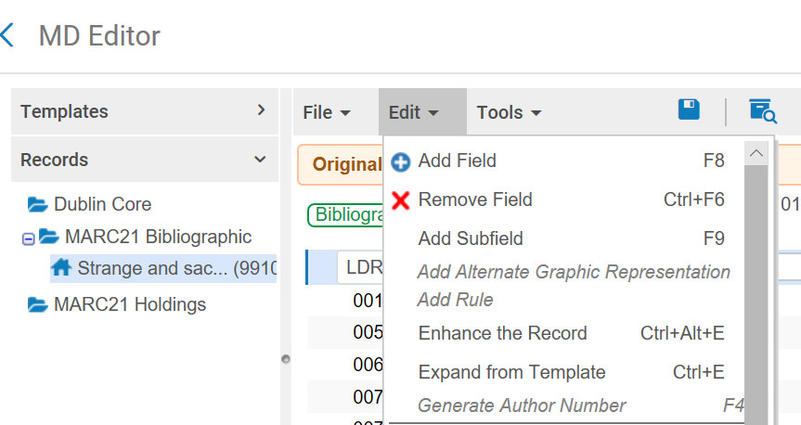
Processes can…
Enhance a record
In Metadata Editor

Slide 7
Normalize records imported
via Search External Resources

Slide 8
Modify records exported into Alma
through an integration profile
(e.g. OCLC Connexion)

Slide 9
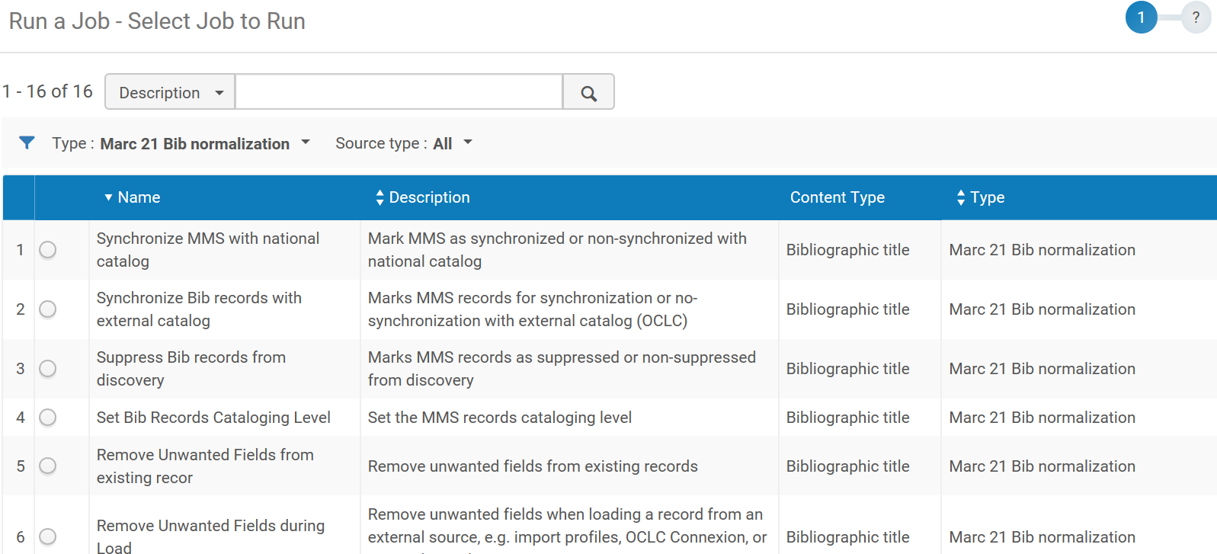
Run as a job on
a set of bib records

Slide 10
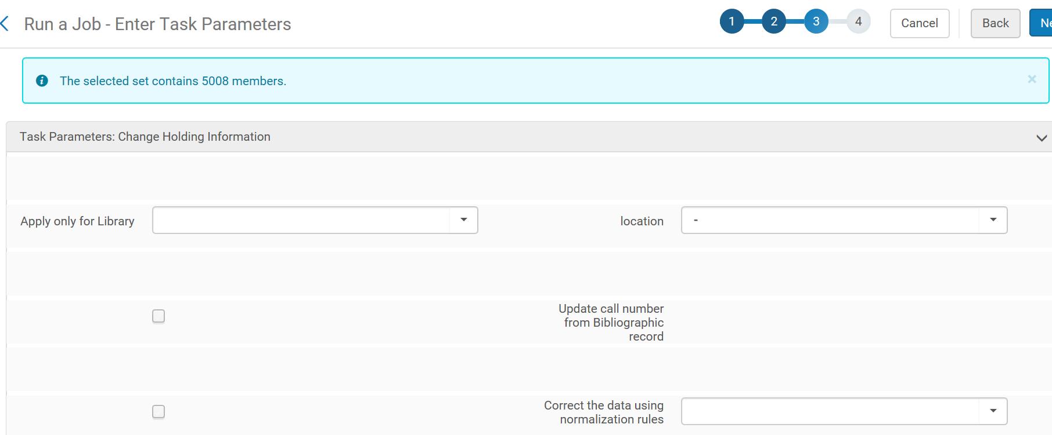
Modify holding records with the
Change Holding Information job

Slide 11
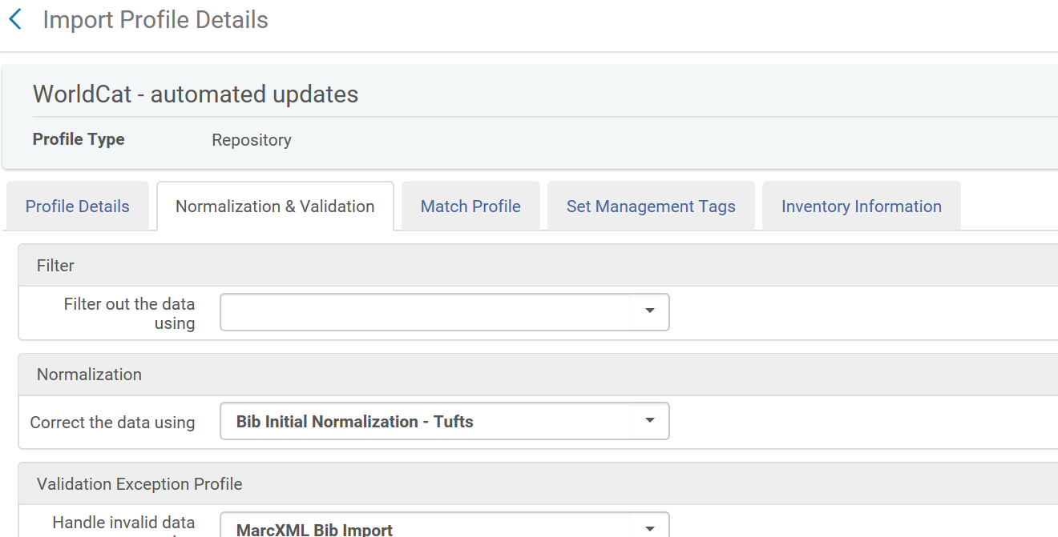
Modify records as they are
imported in an Import Profile

Slide 12
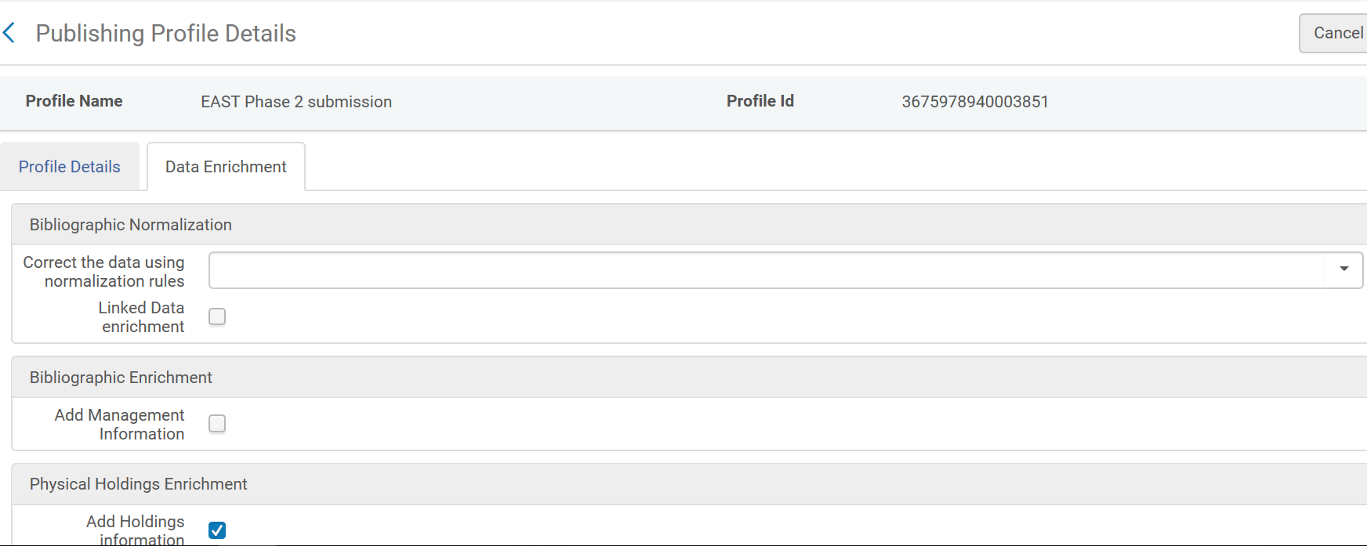
Modify records exported
in a publishing profile

Slide 13
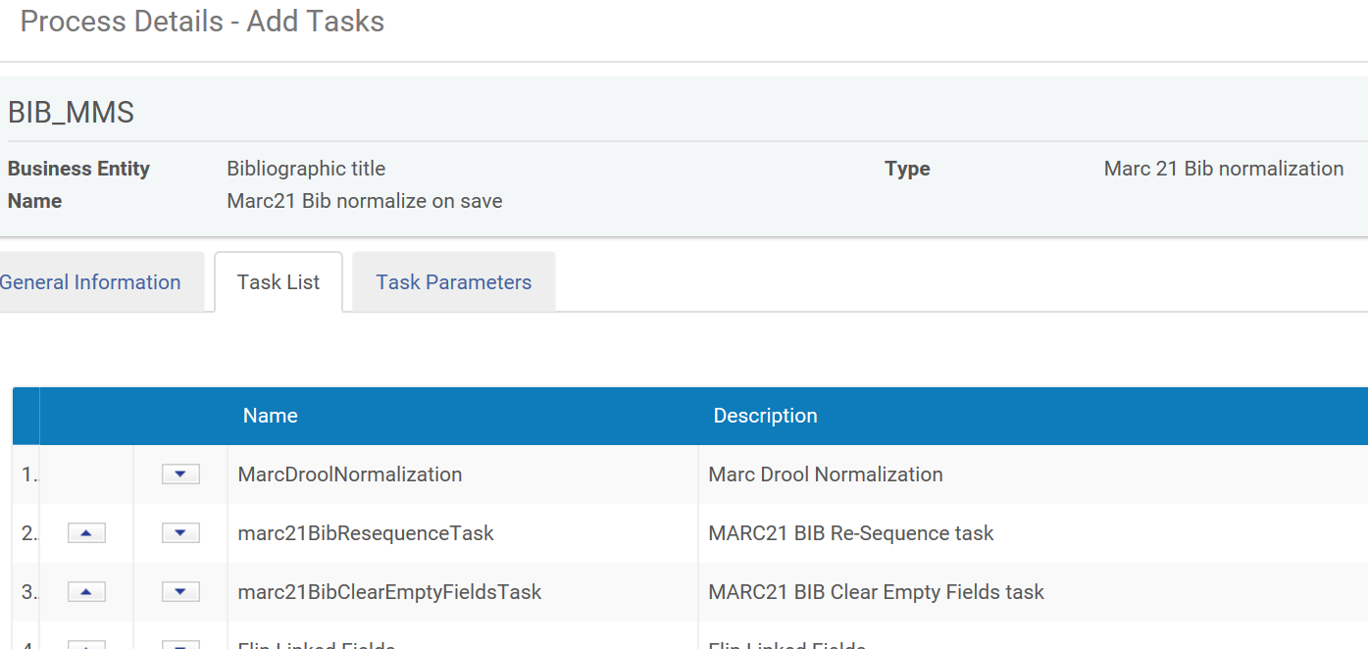
Normalize records every time they
are saved (Normalize on Save process)

Slide 14
Normalization Processes
Processes are created in Metadata Configuration profiles (Configuration > Resources > Cataloging > Metadata Configuration)
Besides executing normalization rule files, processes can sort MARC fields, calculate brief level, change suppression, and other tasks
Instructions on creating processes are in the Alma documentation: Alma Online Help > Resource Management > Configuring Cataloging
Due to time limitations, this presentation will focus on writing normalization rules rather than creating processes

Slide 15
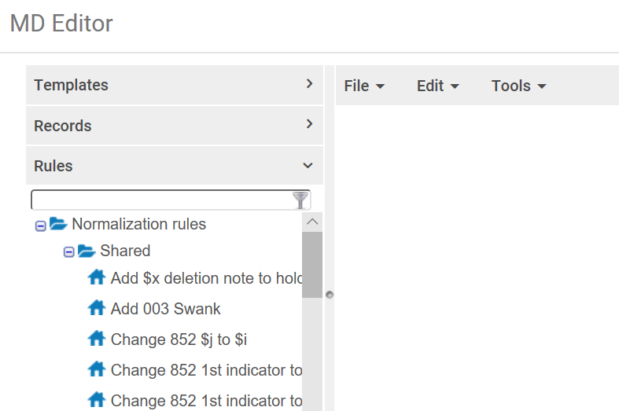
Rules are created
and edited in the
Metadata Editor

Slide 16
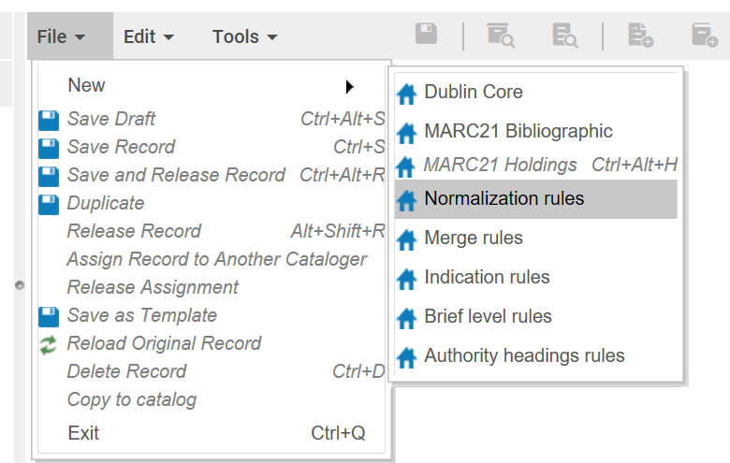
To create a new rule, click
File > New > Normalization rules

Slide 17
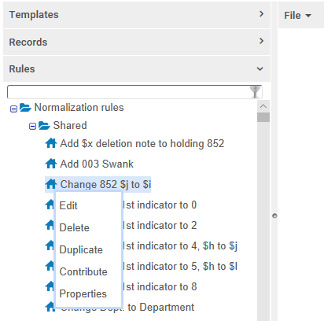
OR, open the
Rules accordion,
click on an
existing rule, and
select Duplicate

Slide 18
TIP: Duplicating is sometimes easier
File > New > Normalization rule produces a completely blank rule; you have to fill in everything
Duplicating helps by providing the general structure of normalization rules: the initial “rule” statement, “when”, “then”, and “end”
If you are lucky, you can duplicate a rule that already includes commands you intend to use
When duplicating, be sure to edit the Name and Description—you may not be able to change them later!

Slide 19
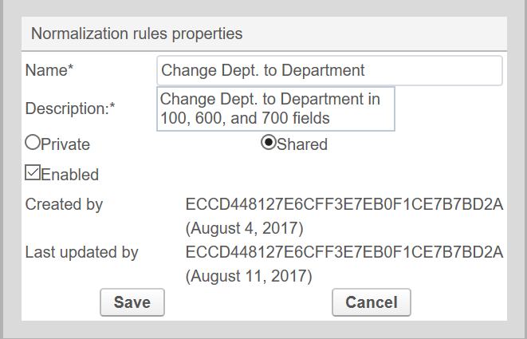
Fill in
Name
and
Description

Slide 20
Change from
Private
to Shared
(or wait until
after testing)

Slide 21
Mark the
checkbox
Enabled

Slide 22
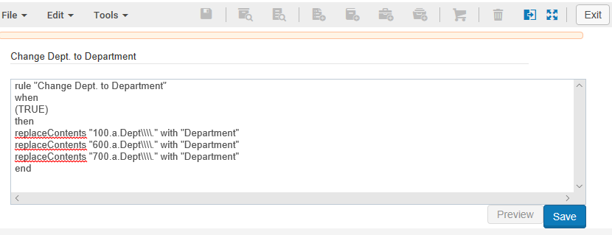
Edit your rule
Click Save

Slide 23
Testing the Rule
Do not use a rule that has not been tested!
Sometimes actions don’t work quite the way you think
If several actions work on the same fields, executing them in the wrong order can yield wrong results
There are a few bugs in Alma which can prevent some sets of actions from working the way you expect
If you use conditions, be sure to test all conditions you expect to see in your records

Slide 24
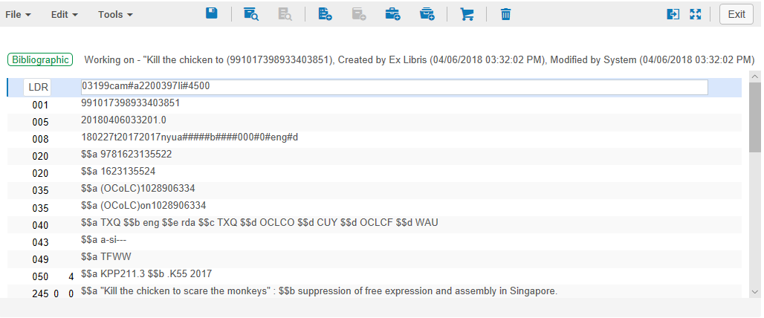
To test a rule…
Open a record in Metadata Editor

Slide 25
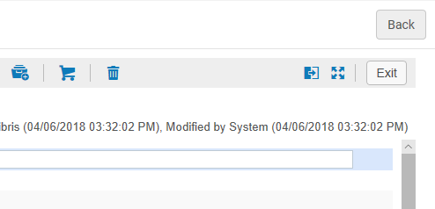
Click the Split Editor button

Slide 26
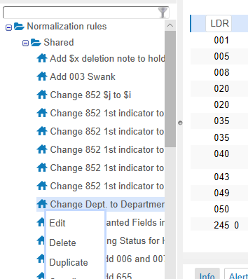
Open the Rules,
click on the rule
to be tested,
and click Edit

Slide 27
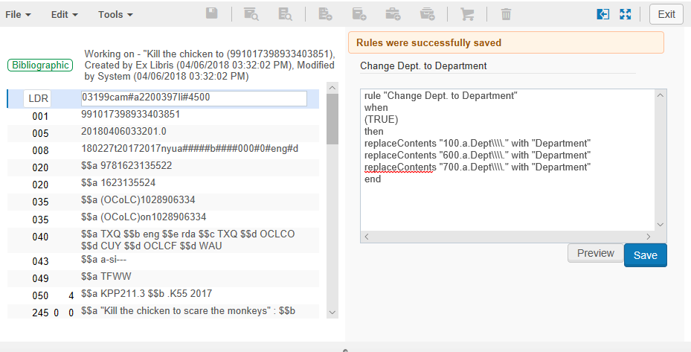
The MARC record and rule
display side-by-side

Slide 28
Edit the rule and/or
the MARC record

Slide 29
Click Preview to see how
the rule would modify the record

Slide 30
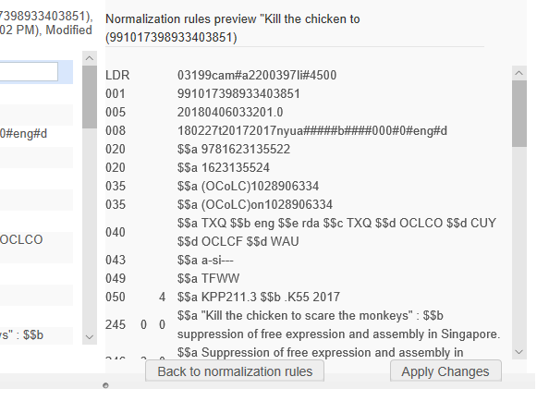
Click this
button
to go
back to the
rule

Slide 31
Continue editing and
previewing until finished

Slide 32
Be sure to save any
changes to the rule!

Slide 33
TIP: Edit the MARC Record for Testing
It is unlikely that a single MARC record will contain all possible conditions that the rule is intended to handle
You can edit the MARC record several times, testing the rule in different ways each time
Try to test as many variations as you expect to see in the records which the rule will be applied to
Test both the TRUE and FALSE conditions of the rule
Be very careful not to accidentally save the MARC record with changes you don’t intend

Slide 34
TIP: Test in the Sandbox
If you have a sandbox, the sandbox provides a safe place to test normalization rules
Create or find records specifically designed to test all the conditions used in your rules file
After testing , copy-and-paste the rule into your production instance of Alma

Slide 35
Basic Syntax of Normalization Rules
rule "add 590, delete 035 (OCoLC)"
when
(TRUE)
then
addField "590.a.Special collections"
removeField "035" if (exists "035.a.(OCoLC)*")
end
Every rule contains
these four lines

Slide 36
rule "add 590, delete 035 (OCoLC)"
when
(TRUE)
then
addField "590.a.Special collections"
removeField "035" if (exists "035.a.(OCoLC)*")
end
Put a name or description in
quotes after the “rule” statement

Slide 37
rule "add 590, delete 035 (OCoLC)"
when
(TRUE)
then
addField "590.a.Special collections"
removeField "035" if (exists "035.a.(OCoLC)*")
end
A Boolean Logic condition
comes after “when”

Slide 38
rule "add 590, delete 035 (OCoLC)"
when
(TRUE)
then
addField "590.a.Special collections"
removeField "035" if (exists "035.a.(OCoLC)*")
end
Normalization actions
come after “then”
Each action is executed
in sequence, first to last

Slide 39
rule "add 590, delete 035 (OCoLC)"
when
(TRUE)
then
addField "590.a.Special collections"
removeField "035" if (exists "035.a.(OCoLC)*")
end
Individual actions can
have conditions, too

Slide 40
Writing Normalization Rules
Follow examples and documentation carefully
Main documentation is in Alma Online Help > Resource Management > Working with Normalization Rules
The documentation gives details about the syntax, conditions, and actions used in normalization rules
Follow the documented format of the actions exactly; e.g. if the documentation does not say you can add indicators in an action, then assume you cannot

Slide 41
TIP: Add White Space
Alma ignores all extra white space in normalization rules
Adding white space makes it easier to read and understand
Add blank lines between logical sections
Add initial spaces to indent lines
You cannot insert tabs in the Metadata Editor, but you can cut-and-paste tabs from a text editor
Add as much whitespace as you want, make it look good

Slide 42
TIP: Add Comments
A line that starts with # is ignored in normalization rules
This is called a comment by programmers
Comments can be used to document the purpose of the rule, explain why it is written a particular way, and to label different sections of the rule
Comments make code easier to understand—remember that someone else may need to edit the rules someday!
I encourage liberal use of comments

Slide 43
rule "add 590, delete 035 (OCoLC)"
# This demonstrates using comments and whitespace
when
(TRUE)
then
# add a local Special Collections note
addField "590.a.Special collections"
# delete OCLC numbers
removeField "035" if (exists "035.a.(OCoLC)*")
end

Slide 44
Some Common Normalization Actions
addField
addSubfield
copyField
removeField
removeSubfield
replaceContents
replaceSubFieldContents
addControlField
removeControlField
replaceControlContents
prefix
suffix
and many more

Slide 45
Specifying Fields, Subfields, Control Fields
"650" = MARC field 650
"650.a" = 650 subfield a
"650.a.Biology" = 650 subfield a with a value of “Biology”
"650.{-,0}.a.Biology" = 650, indicators blank and 0, subfield a with a value of “Biology”
"008.{23,1}.o" = control field 008, position 23, length 1, with a value of “o”
"LDR.{6,1}.a" = LEADER, position 6, length 1, with value “a”

Slide 46
Conditional Clauses
Conditions can apply at the record level or at the action level
Conditions test the existence of a specified element: a field, field+subfield, field+indicators, field+subfield+value, etc.
Multiple conditions can be linked by Boolean operators (AND, OR) and grouped in parentheses
Available conditional statements:
TRUE, exists, not exists, existsControl, not existsControl, existsMoreThanOnce

Slide 47
Examples of Conditions
(TRUE) only used for record-level conditions
(not exists "245.b")
((not existsControl "006") AND (not existsControl "007"))
(exists "650.z.United States")
((exists "650.{-,0}") OR (exists "650.{-,2}"))
(existsMoreThanOnce "050.b")
((existsControl "LDR.{6,1}.a") AND ((existsControl "LDR.{7,1}.s") OR (existsControl "LDR.{7,1}.i")))

Slide 48
Conditions at the Record Level
Conditions after “when” evaluate an entire MARC record
Record-level conditions are required; use the condition (TRUE) if you want the rule to be applied unconditionally
If the MARC record evaluates as FALSE, the actions in the rule will not be applied to that MARC record
If multiple MARC records are processed, each MARC record is evaluated separately; only records which evaluate as TRUE will be modified by the normalization rule

Slide 49
Conditions at the Action Level
A condition in an action statement applies only to that action
The condition tests each field to determine whether the action should be executed on that field
A condition can be appended after any action statement, on the same line
The format is: action_statement if (condition_statement)
Example:
removeField "655" if (exists "655.7.local")

Slide 50
Wildcards and Special Characters
An asterisk (*) is a wildcard character which can match any string, including a string of zero length, e.g.:
replaceContents "245.c. ; *" with ""
removeField "035" if (exists "035.a.(OCoLC)*")
To use a literal period in a value, precede it with four backslashes, e.g.:
replaceContents "650.a.Dept\\\\." with "Department"
See the documentation for more info on special characters

Slide 51
Normalization Rules in the Community
The list of available normalization rules includes a section of rules contributed by the community
Community rules can be duplicated locally, edited, and used
Many contributed rules are useful as examples or models
To contribute a rule, click on the rule and select Contribute
Please test your rules fully, and make them as understandable as possible, before contributing them

Slide 52
General Advice
Read the documentation, training resources, and examples
Look through the community-contributed rules for ideas
Carefully follow the documented format of actions
Test everything
Make sure your rules can be understood by someone else
Try things out—you can do this

Slide 53
Alma Knowledge Base Resources
Product Documentation > Alma Online Help > Resource Management > Working with Normalization rules
Product Documentation > Alma Online Help > Resource Management > Configuring Processes
Training > Extended Training > Normalization Rules in Alma
Training > Extended Training > Presentations and Documents – Rules

Slide 54
Thank you!
You may contact me at:
steve.mcdonald@tufts.edu

