Slide 1
Connecting to Other Systems
Walter Komorowski
Head of Library Systems
Williams
ELUNA 2018

Slide 2
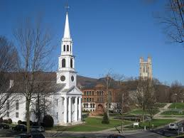
Who we are
Williams - 2100 students 40 graduate students
Highly Competitive Liberal Arts College
In Massachusetts - a stone’s throw of Vermont and New York
Part of the Boston Library Consortium
Millennium for over 25 years

Slide 3
We wanted currency and automation
III
Patron authentication via barcodes; staff via local usernames/passwords
ILLiad authentication by user created username/ password
Patron data load once a year - students only
Weekly output to Financial office (Accounts Payable)
Once a semester output to Bursar’s Office via excel
Cataloging and LHRs via Connexion client
SFX - update of Elsevier, but MARC records separate via SerialsSolutions

Slide 4
What we achieved
Alma
Patron and staff authentication via Shibboleth using Williams login
  Now use for everything including ILLiad
Patron data updated nightly - students; faculty;staff; others
Nightly output to Financial office (Accounts Payable)
Nightly output of fines and credits to Bursar Office
Holdings (symbol) set in nightly jobs for OCLC; export and ftp of original cataloging
Update of Elsevier and Ovid holdings weekly (E-book Central also possible)
ILLiad integration with fulfillment for borrowed items

Slide 5
What we lost
Troubleshooting was easier in old system, e.g., we had access to patron barcode and their password was last name
Lost control of some customizations in order to make automation smoother, e.g., reviewing student fines and fees before they went to the Bursar’s Office
SFX is/was a more customizable resolver

Slide 6
What really happened
Most processes are automated; most run smoothly
Frustration in setting up some systems - unexpected results
We were surprised frequently, but there usually was light at the end of the process
We found we had to change both procedures and policies

Slide 7
What you need
Integration Profile
Local server - ours is divided between from Williams and from Alma - waystation
  Access from off campus is strictly controlled
Good working relationship with your IT staff - clearly define your objectives
Someone who understands the local campus software environment - we are a peoplesoft site
Programmers who can transform mostly XML into formats usable by other systems
Resources on the developer’s network
Patience
LETS TALK SPECIFICS ----

Slide 8
Authentication
SAML - Shibboleth
Williams joined Incommon Federation
Strong recommendation - get Shib working with other resources first
We do not have discovery turned on within our InCommon profile- we create a unique idp entry for each resource. I attempt a login in after setting it up with a provider - release attributes
We started with JSTOR

Slide 9
Authentication - What is required
SAML - Shibboleth
SAML integration profile
Certificate and files on ALMA server side
IDP profile that determine what to share
https://developers.exlibrisgroup.com/alma/integrations/user-management/authentication/inst_idp/saml

Slide 10
Authentication - IDP Profile
$IDP_HOME/conf/attribute-filter.xml
<!-- ExLibris Alma -->
<AttributeFilterPolicy id="alma">
<PolicyRequirementRule xsi:type="Requester" value="https://na02.alma.exlibrisgroup.com/mng/login" />
<AttributeRule attributeID="eduPersonScopedAffiliation">
<PermitValueRule xsi:type="ANY" />
</AttributeRule>
<AttributeRule attributeID="employeeNumber">
<PermitValueRule xsi:type="ANY" />
</AttributeRule>
</AttributeFilterPolicy>

Slide 11
SAML - Good and Bad and Other
Good
Reliability
Expanded beyond Alma
Bad
Our OIT limits to Williams users and does not create off campus accounts
Alternatives
Google apps for education allow two factor; idp alternative

Slide 12
Fulfilment
SIS Integration Profile - - 2 methods - sync and import
We get faculty/staff and a student patron file from peoplesoft every night
Started with students and faculty and staff
Added research associates, etc.
Added emeritus faculty
Adding spouses - anyone with benefits is in peoplesoft
The file is an XML that has been compressed into a zip file
https://developers.exlibrisgroup.com/alma/integrations/user-management/sis/synch

Slide 13
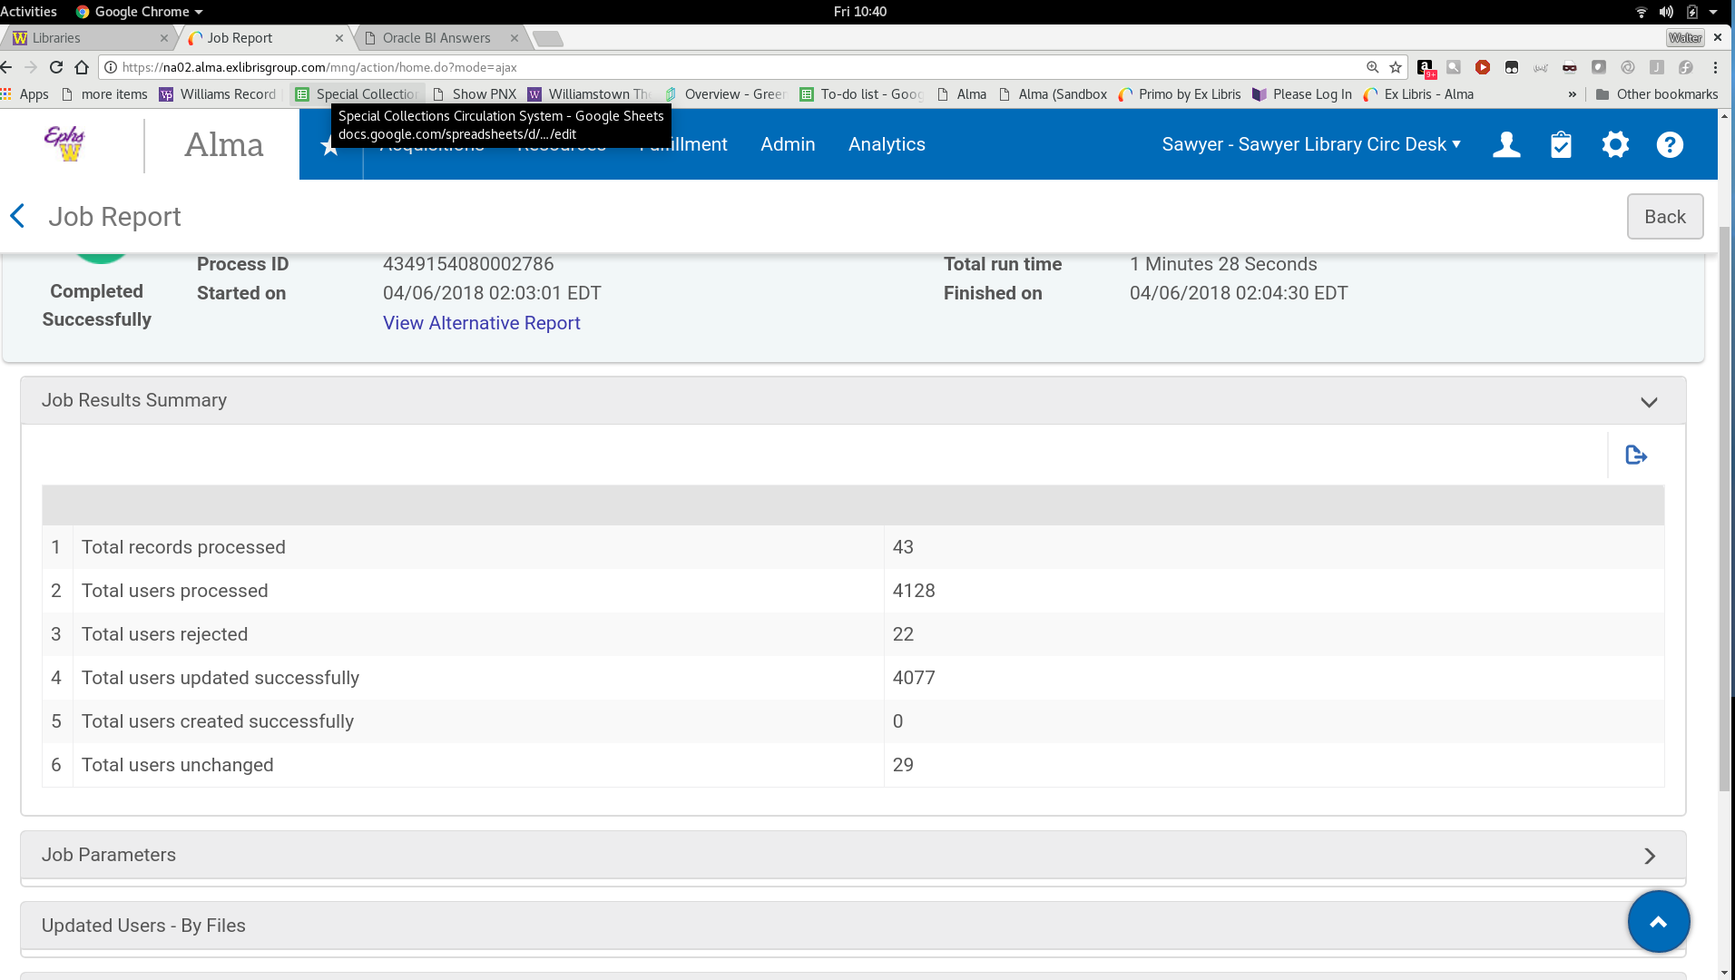
Fulfilment
Check the load report regularly

Slide 14
Fulfilment
Check load reports regularly. It will complete with errors and some records will not be updated
Biggest problem is that people go in and out of statuses
Does not load two records from the same load with the same ID
Expire seniors/graduates on 5/25
Move seniors with materials to a new patron group - seniors with books which is part of the credits integration
Analytic to look at external users that have not been updating

Slide 15
Fulfilment
Self Check
One for each self checkout
STunnel - we have it running on the self check - self-signed certificate that allows encrypted information to flow between Alma and the self check out - SSL
Integration profile - you upload the the certificate
https://developers.exlibrisgroup.com/alma/integrations/selfcheck

Slide 16
Financial
Nightly output to accounts payable.
Majority of our invoices are EDI - YBP self checkout, EBSCO, Wiley, etc
Output to sftp server and a cron job triggers a copy to a second server, a program in Peoplesoft then pulls the file from that second server into people soft for processing.
Issues
We have not been able to get payment information imported back into the system - the identifier does not travel
We still need to send over paper versions of the vouchers

Slide 17
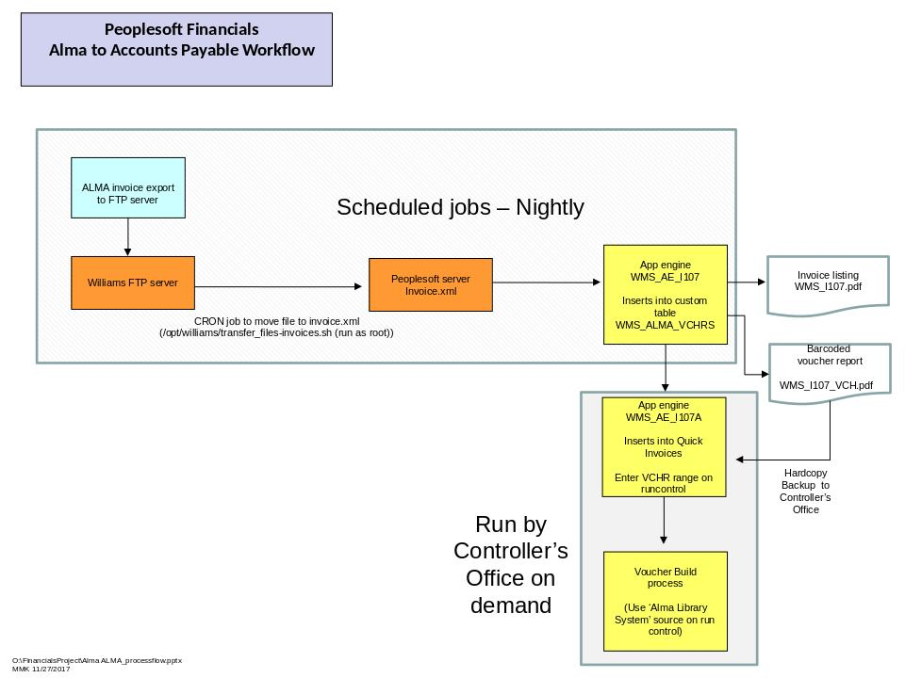

Slide 18
Bursar
Output all charges over $5 and all credits as 2 separate files
Previously we only output once at the end of the semester as an excel file.
Bursar triggers copying of the file which transforms into a tsv/excel that is brought into PeopleSoft and added to turn bills
Problem:
Too many charges - needed to change policies
Result:
Elimination of fines - reimbursement of fines

Slide 19

OCLC

Slide 20
OCLC
The most difficult
OCLC was switching to the new Collection manager
Takes weeks to set up and have profile approve at OCLC
Takes several more weeks after submitting first file for first report
Things seem to work, but then …
  We swear something changed
  OCLC was adding our records to different OCLC numbers

Slide 21
OCLC
Solution:
Set up match on OCLC # only
FTP Original Records

Slide 22
Elsevier
We already had automatic holdings set up for Elsevier in SFX
You set up an integration profile
You need a token from Elsevier
Every weekend our holding update
https://knowledge.exlibrisgroup.com/Alma/Product_Documentation/010Alma_Online_Help_(English)/090Integrations_with_External_Systems/030Resource_Management/050Upload_Electronic_Holdings_from_Elsevier
Occasional glitches

Slide 23
OVID
You set up an integration profile
You need an OVID account ID that you put in the URL of the integration profile https://Charlotte.ovid.com:8443/OrionAPI/rest/Reporting/KBARTHoldings/<Ovid group name>?UserName=<user name>&Password=<password>
https://knowledge.exlibrisgroup.com/Alma/Product_Documentation/010Alma_Online_Help_(English)/090Integrations_with_External_Systems/030Resource_Management/045Importing_Ovid_Portfolios
Preprints are not represented in holdings; closed holdings

Slide 24
RapidILL
Publishing Profiles
Books, journals, and media
Problem we are having is job does not complete - BLC maybe scheduling
https://developers.exlibrisgroup.com/blog/Alma-RAPID-OAI-Setup-and-Configuration

Slide 25
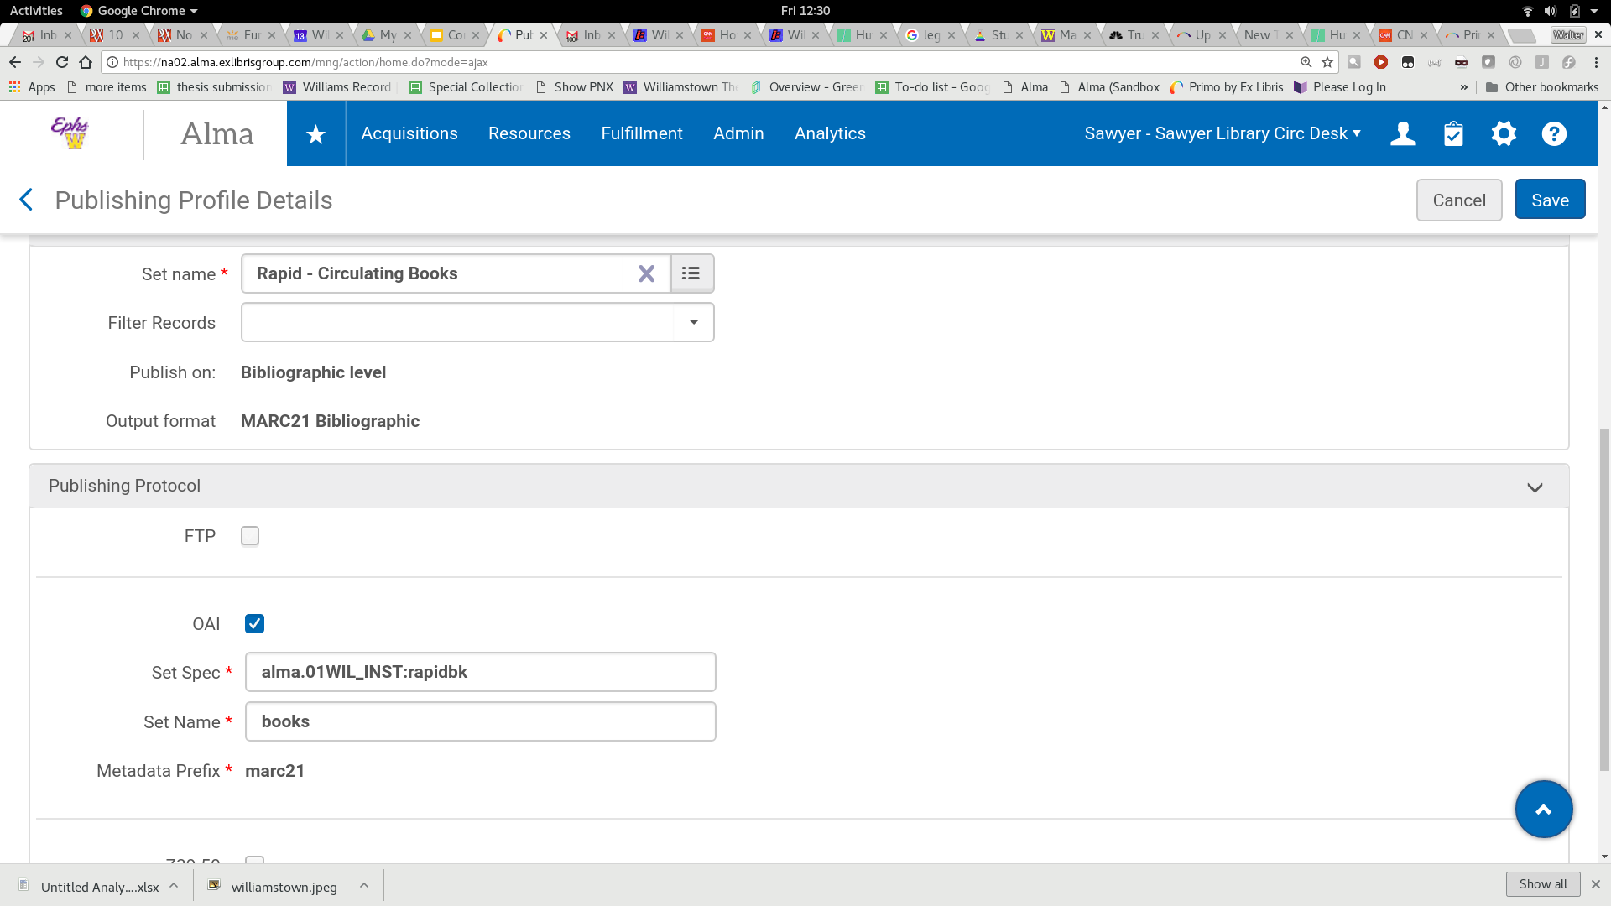

Slide 26
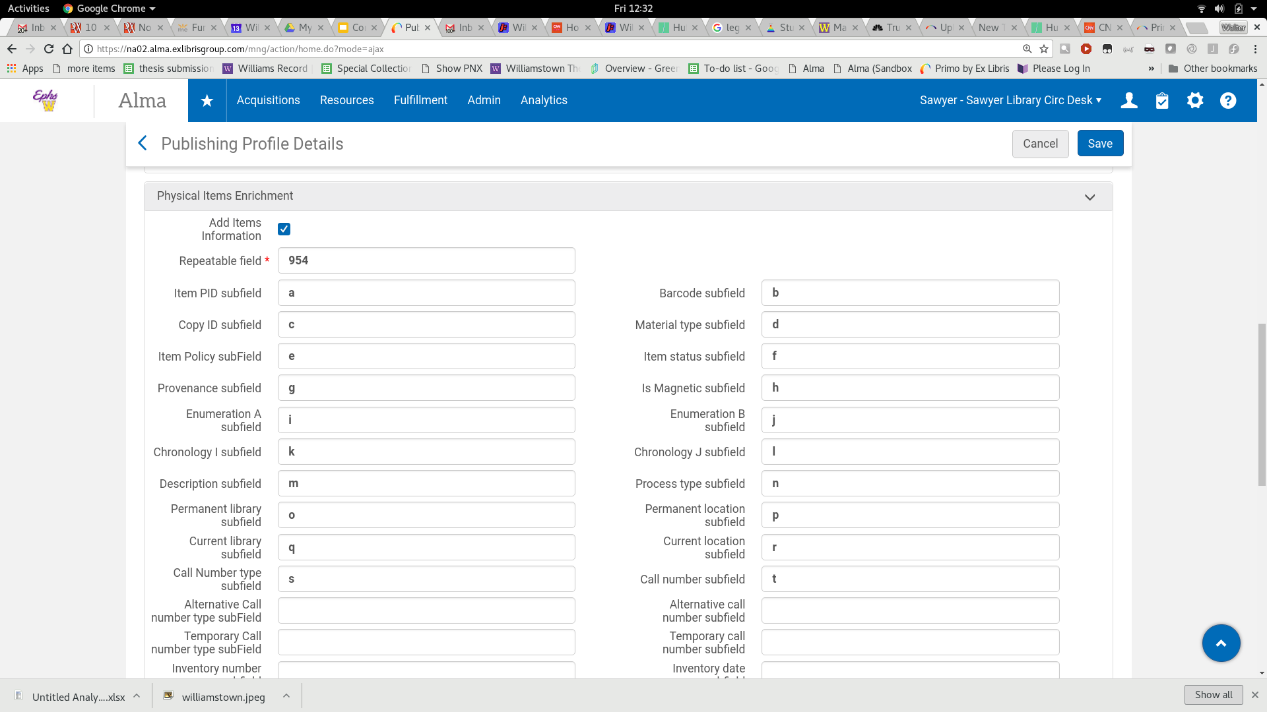

Slide 27
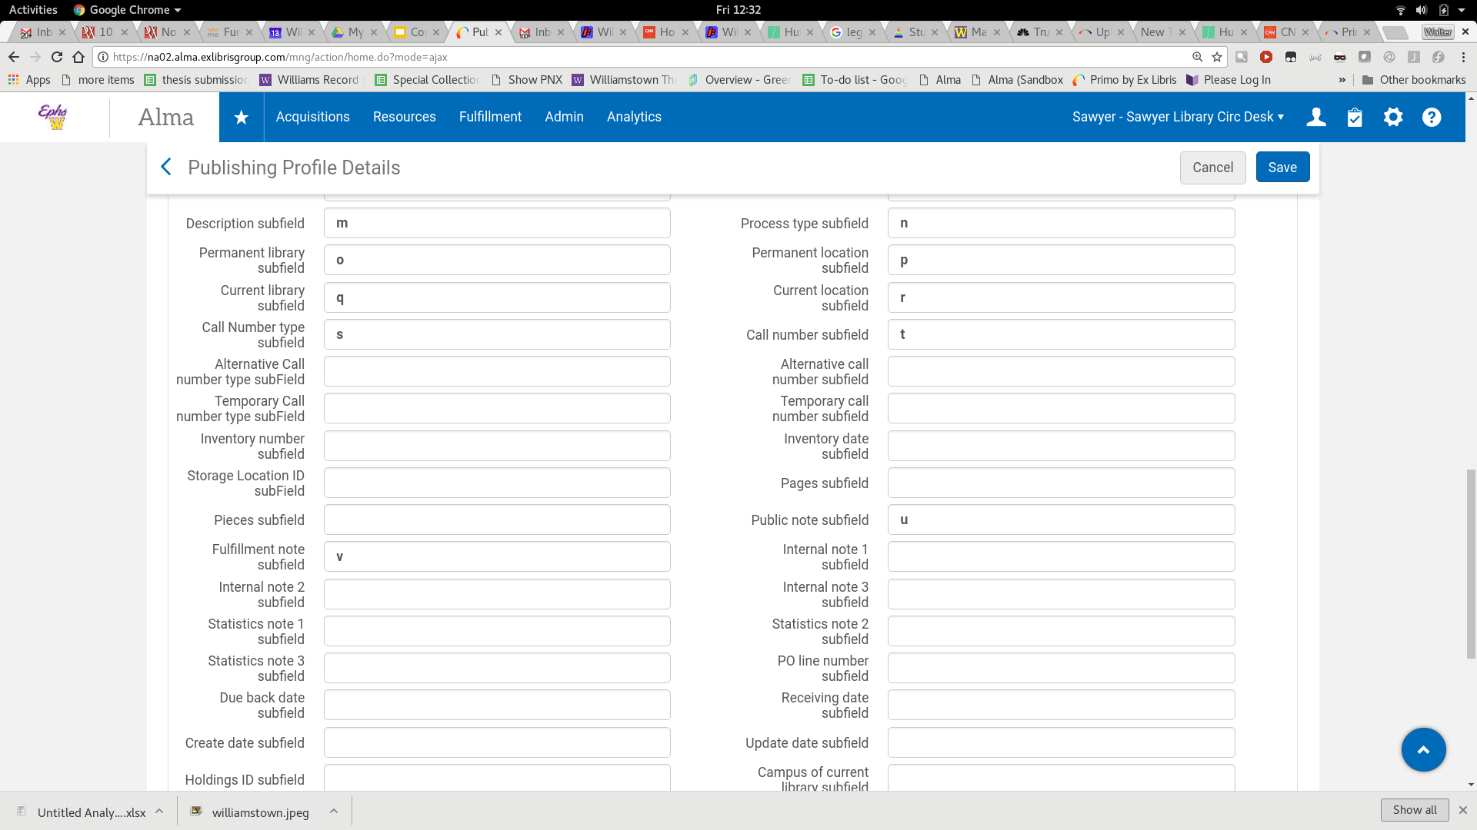

Slide 28
ILLiad
In Millennium we used ArticleReach system - INNReach for articles
We had ILLusername use in ISO email request as part of our patron downloads
Use that as part of our AdditionID login name
Setup in Resource Sharing Partners
Fullfillment Configuration| Resource Sharing Library | Create Temporary Items
https://prometheus.atlas-sys.com/display/ILLiadAddons/ILLiad+ALMA+NCIP+Client+Addon
https://developers.exlibrisgroup.com/blog/ILLiad-add-on-for-NCIP-based-integration-Alma

Slide 29
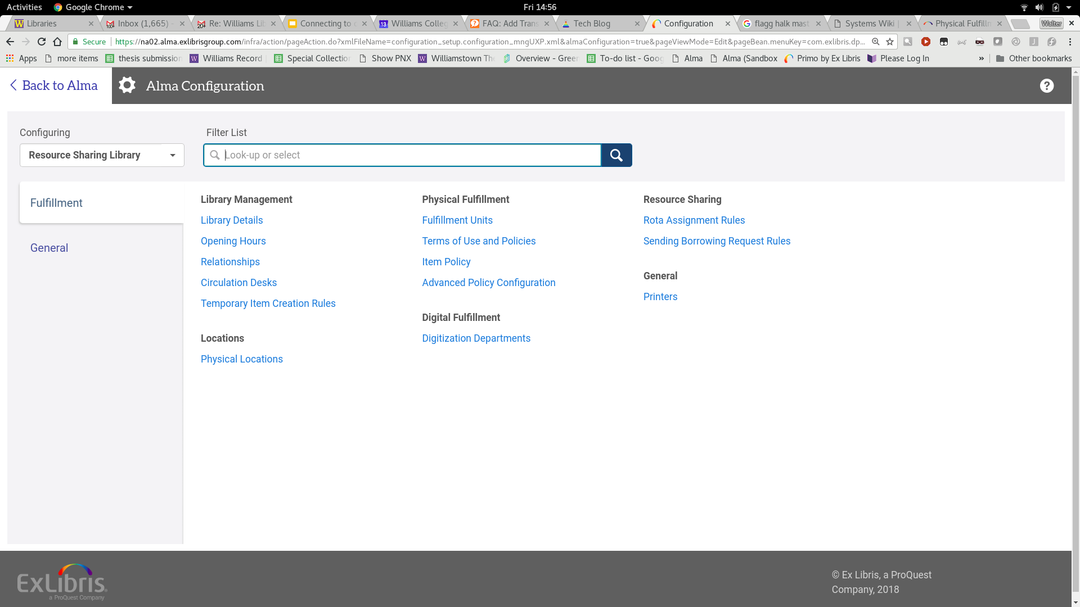

Slide 30
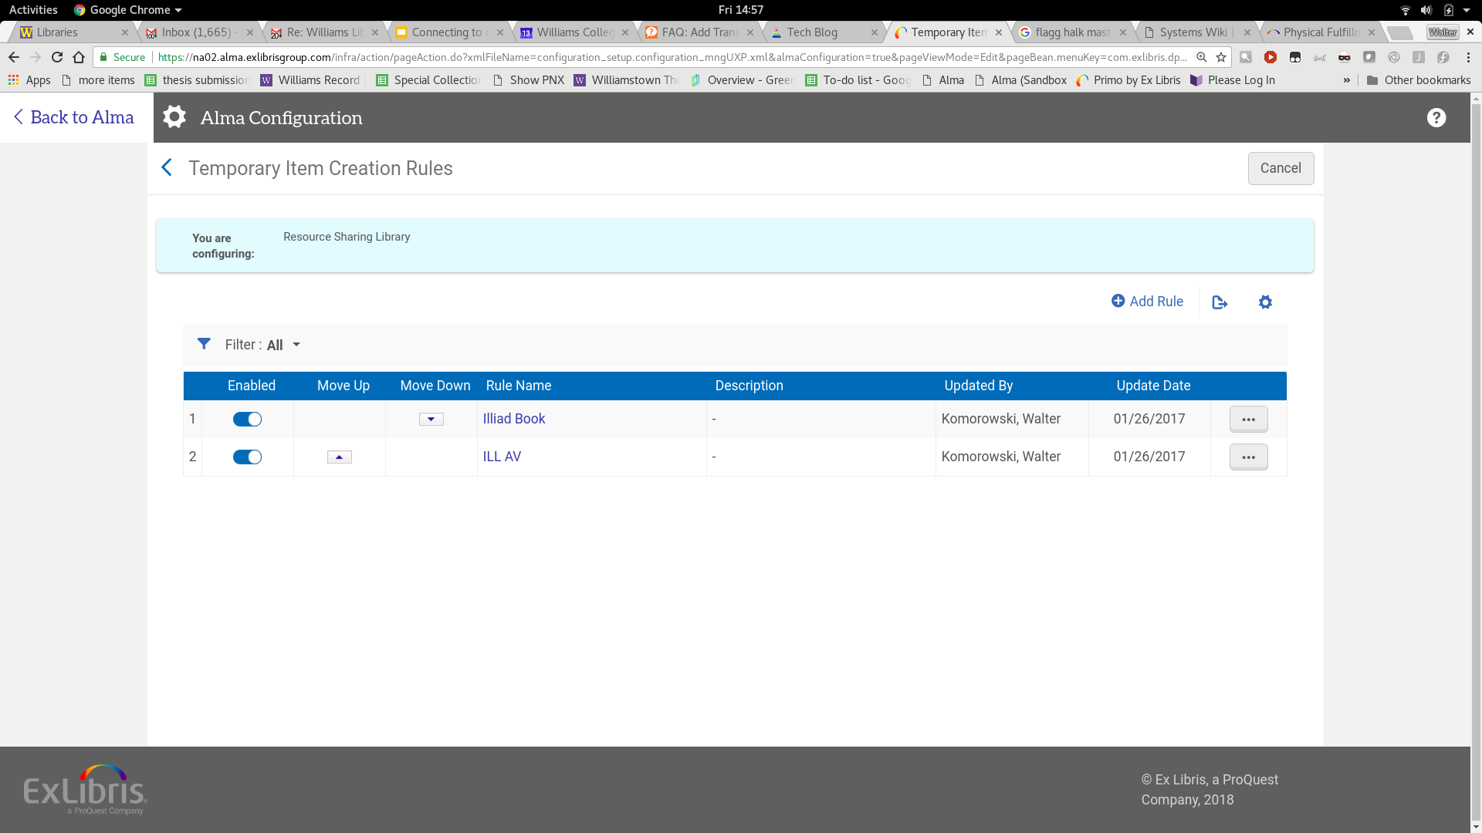

Slide 31
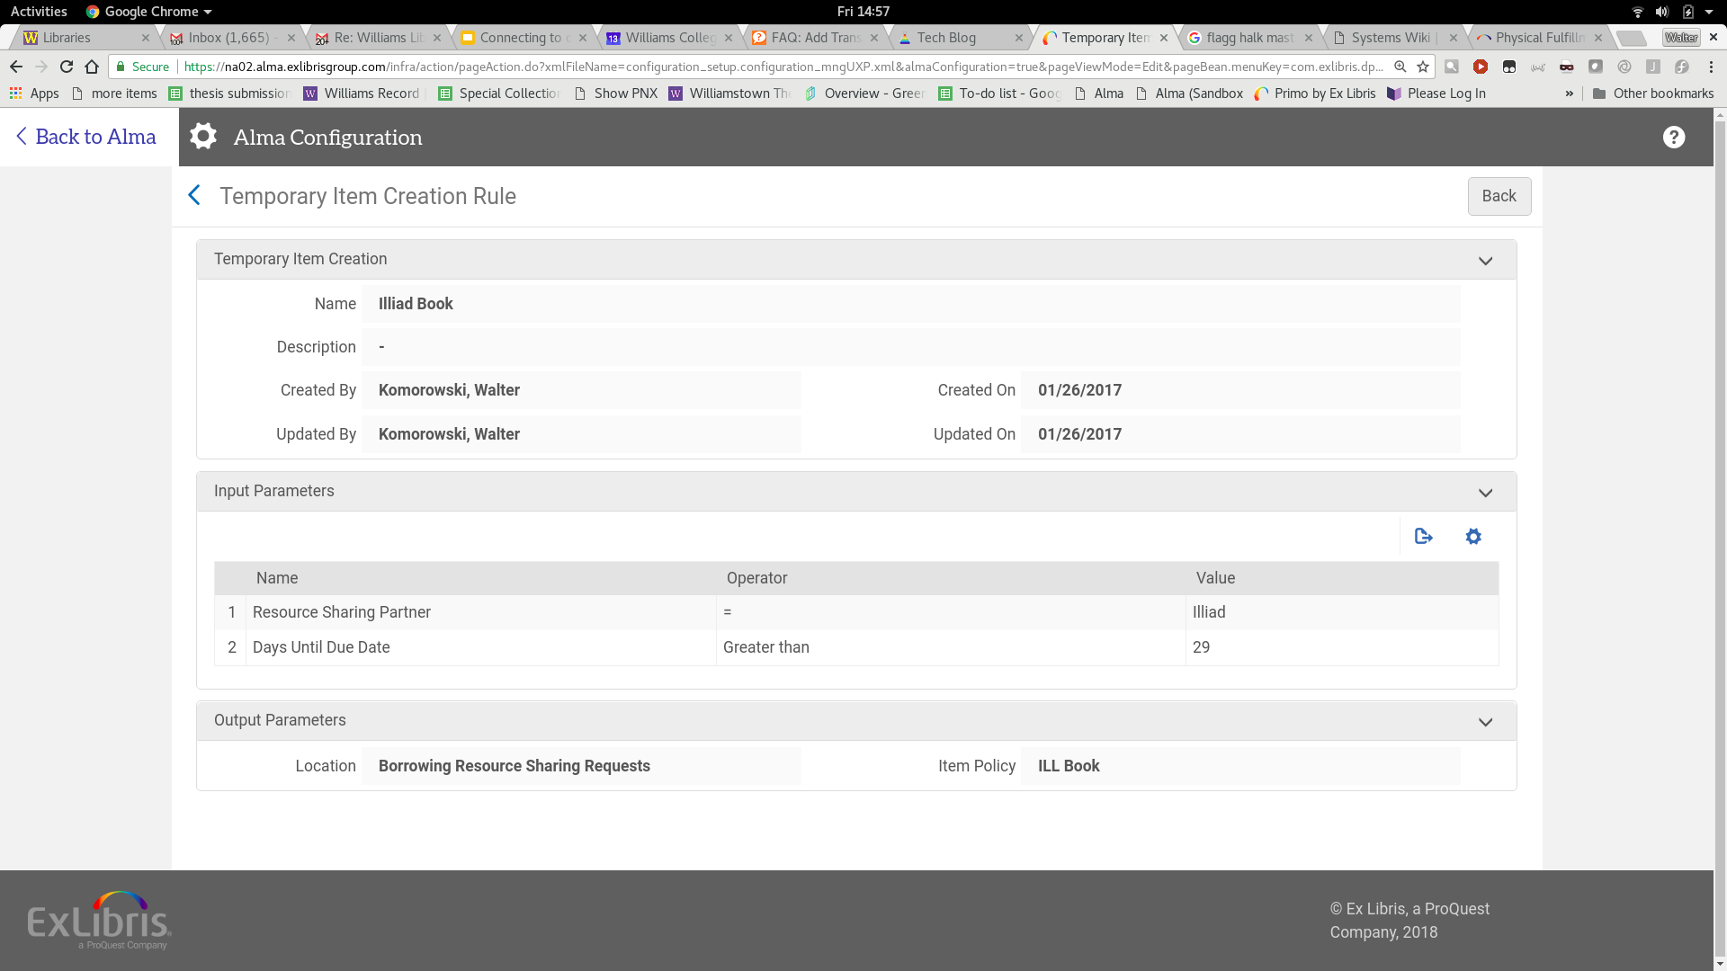

Slide 32


Slide 33
Other integrations
Z39.50
Google Scholar

Slide 34


